Slide 1
DATA COMMUNICATION AND NETWORKING-LABORATORY
CAP276
Practical: Downloading and installing Cisco packet tracer

Slide 2
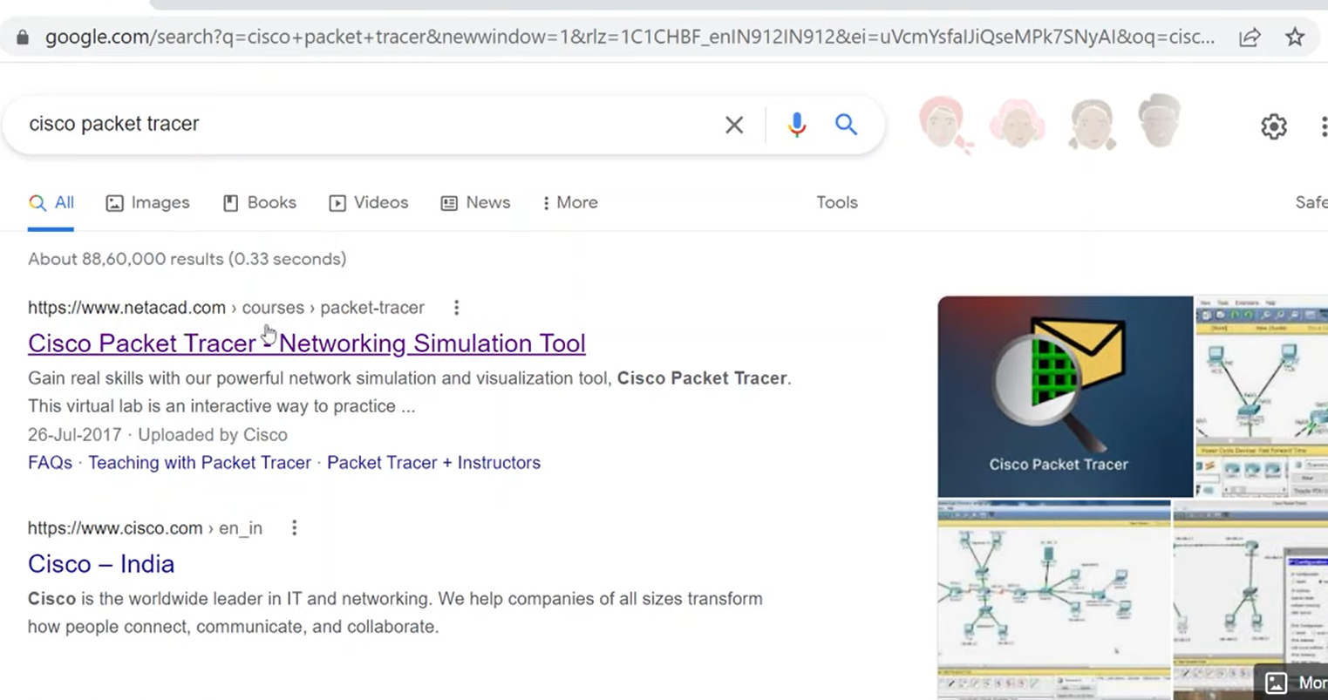
Step 1: Open Google Search Engine type Cisco packet tracer
Step 2: Click on “Cisco Packet Tracer - Networking Simulation Tool”

Slide 3
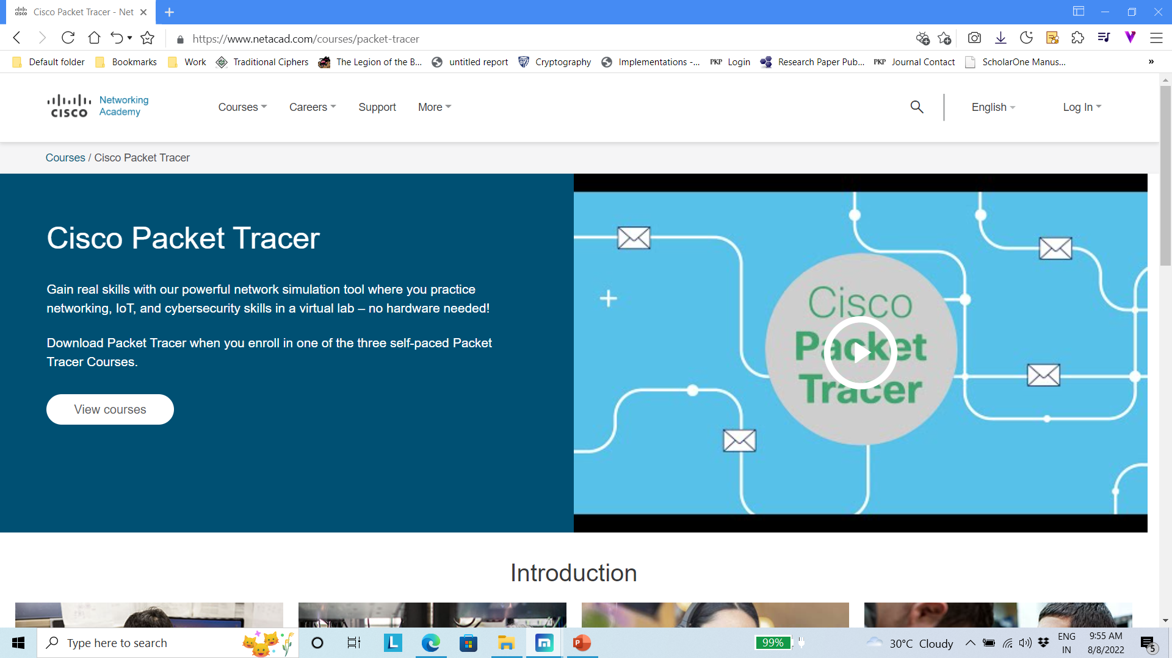
Step 3: Scroll Down

Slide 4
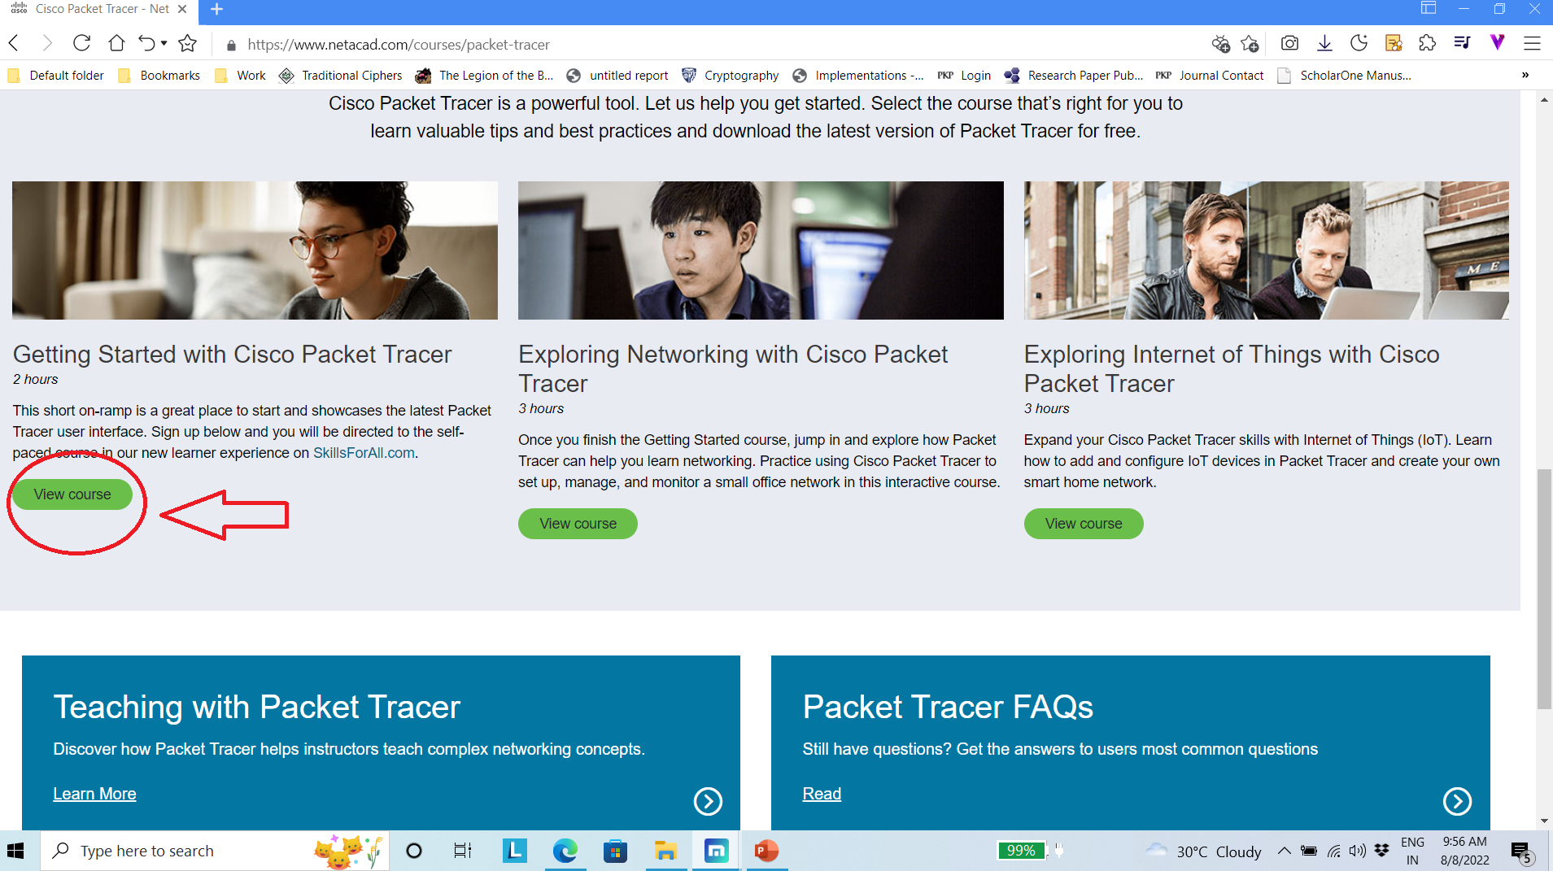
Step 4: Click on View Course

Slide 5
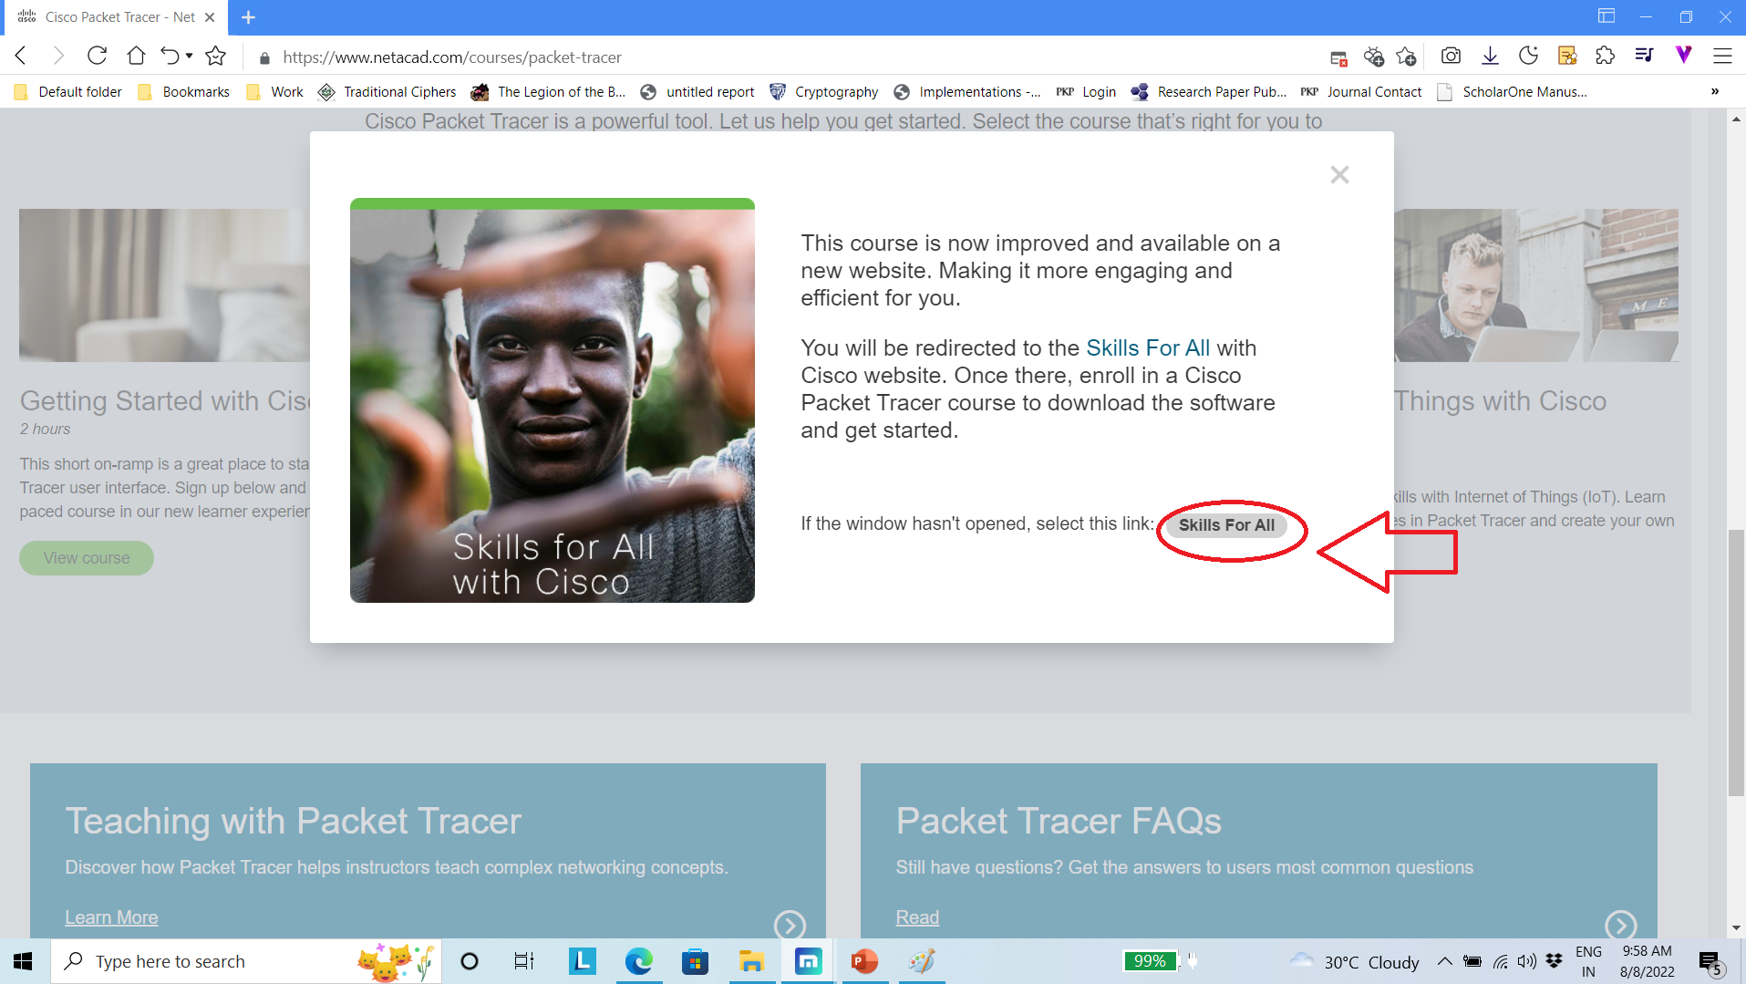
Step 5: Select Skill for all

Slide 6
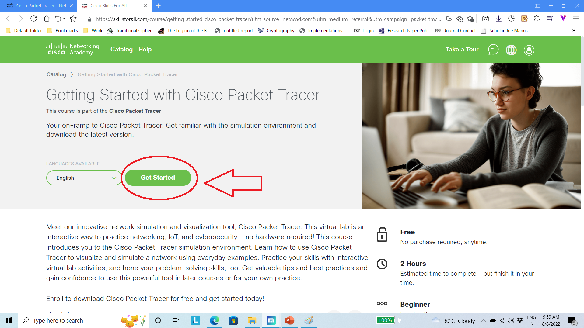
Step 6: Click on Get Started

Slide 7
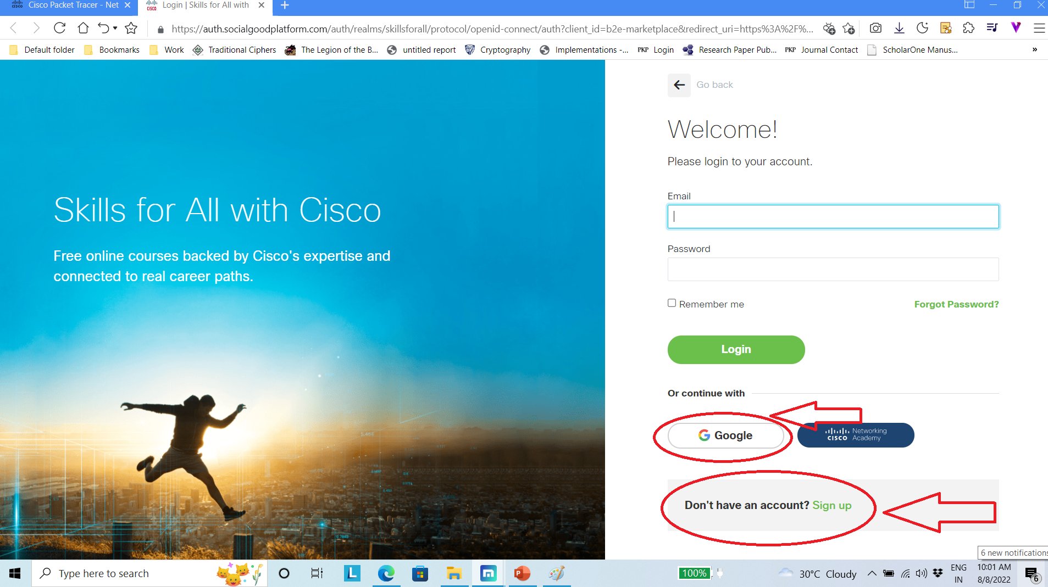
Step 7: Create your account or log-in with your Gmail account

Slide 8
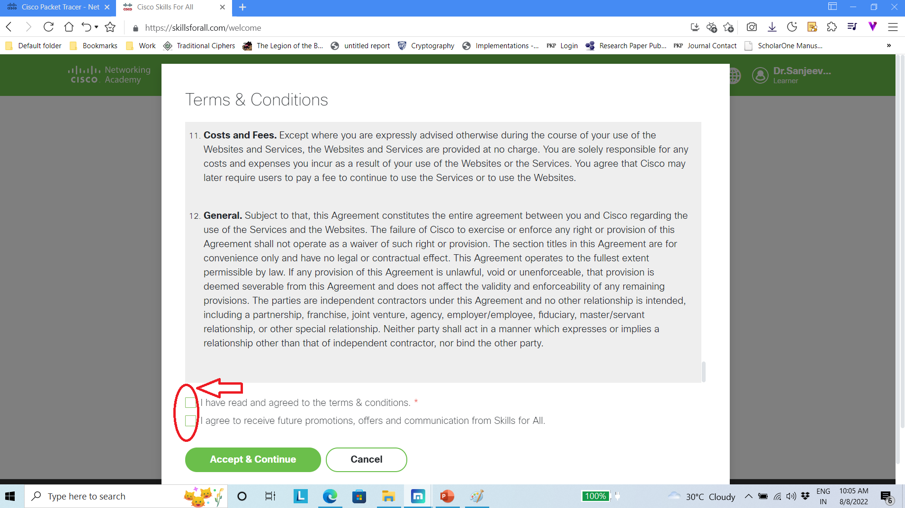
Step 8: Follow the Step Step 9: Click on Terms & condition

Slide 9
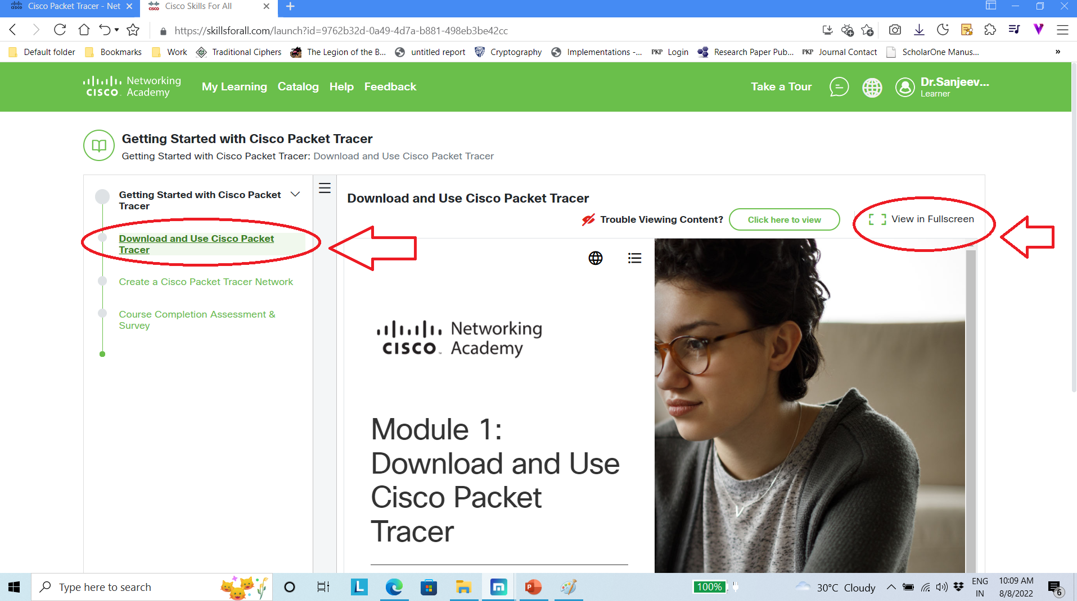
Step 10: Select Download and use cisco packet tracer Step 11: Click on View in Fullscreen

Slide 10

Step 12: Select Install Cisco packet Tracer Step 13: Scroll Down

Slide 11
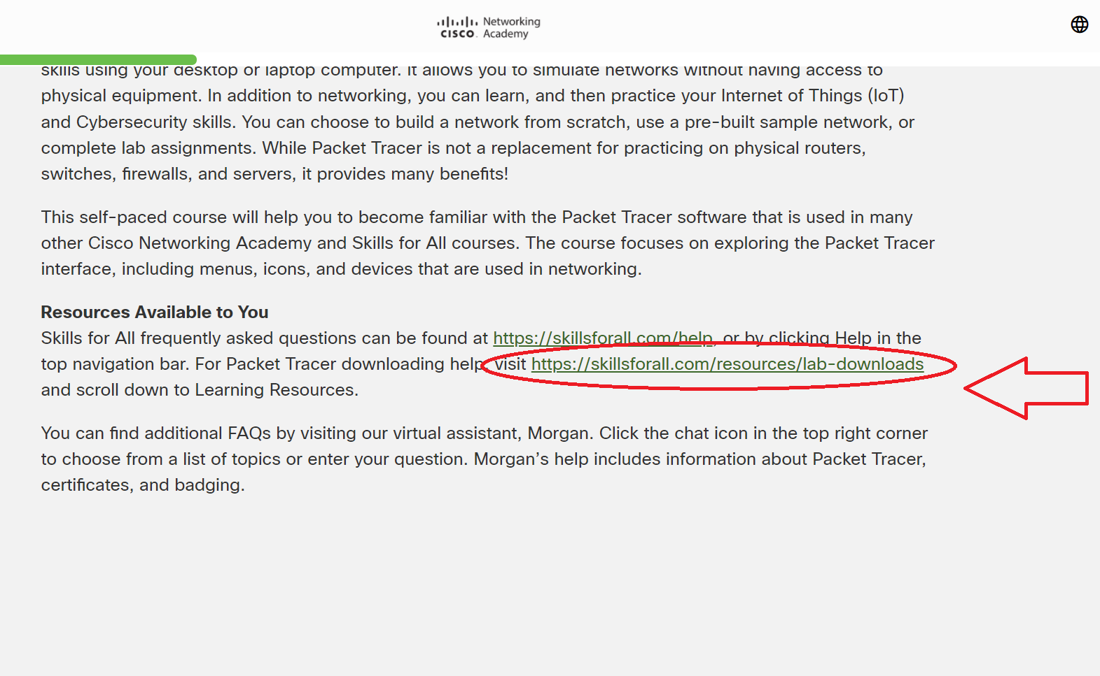
Step 14: Select highlighted download link 2nd one

Slide 12

Step 15: It will redirect to this page Step 16: Scroll Down

Slide 13
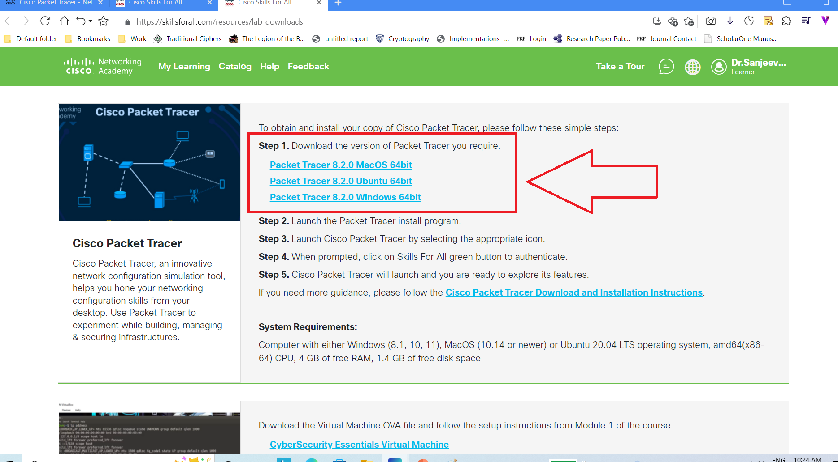
Step 17: Click on Download Step 18: Follow the Downloading Instructions

Slide 14
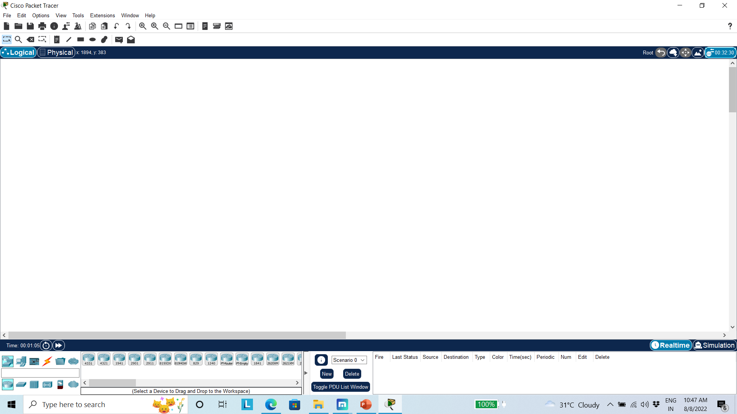
Step 19: Cisco Packet Tracer Window

